Slide 1
How to be a Parliamentarian
Online Nationals 2020

Slide 2
Contents of the Presentation
How do I access the chamber?
What will my chamber look like?
How do I start Session 1?
How do I run a PO election?
What else is different?

Slide 3
How do I access my chamber?
If you’ve made it here, you can access your chamber.
Tomorrow, you’ll receive your chamber assignment through Tabroom.com.
Go to the Congress Wing (CON) and find your room.
Choose the Zoom App function. Use Gallery View.
If you’re not assigned for Session 1, go to the Congress Judging Pool Room.

Slide 4
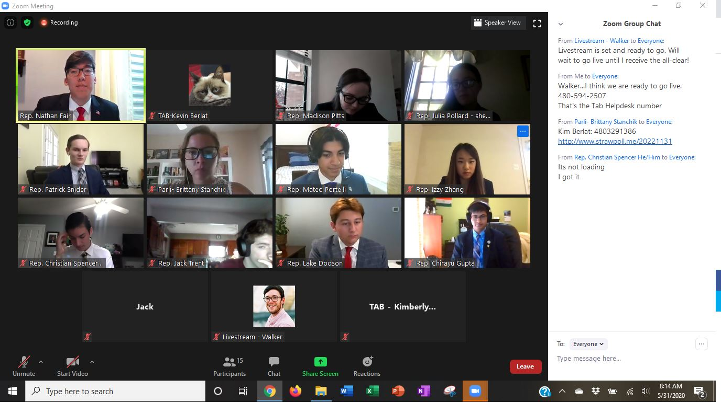
What will my chamber look like?

Slide 5
Session 1
Arrive at 1:00 pm Central Time.
A tab member will be in and out taking attendance and checking on your room. They should make you the host of the room.
They will give you two links: a Voting Election Record and a PO Advancement Form.
Do tech checks with the students. Can you hear and see them? Can they hear and see you? If there are issues, ask the tab staff first.
When everyone is there and ready, deliver the Oath of Office at 2:00 pm. This is included in your Parliamentarian Guide.
Run a PO election.

Slide 6
PO elections
If the PO is unopposed, you do not need an election…but you do need to fill out the Election record.
Open the link for the record Google Sheet and write the name of the PO with “unopposed” in Vote #1.
If you do have a contested election, go to www.strawpoll.me
Run an election. If you need runoffs, great. Your election must have a majority decision.
Fill out the Election record for each vote.

Slide 7
Session 1
When you have an elected PO, give them the link to the PO Advancement form. They must fill this out before the end of the session.
You will not have a ballot until Session 3, but you will have a Precedence List in Tabroom. This is to help the PO streamline their decision-making process. You will receive a new list each session. Share it with them in a private chat.
If you run into trouble, ask a tab member. If none is around, go to the helpline located on the room webpage. Worst case scenario, text or call the helpdesk phone listed in your Parliamentarian Guide.
The sessions are 2 ½ hours. Do not end early.

Slide 8
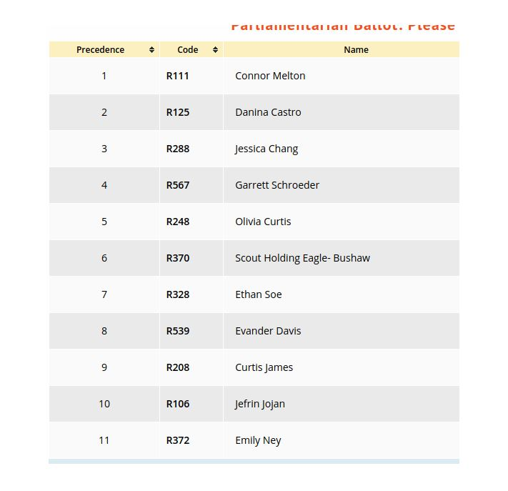

Slide 9
Session 1
When you have an elected PO, give them the link to the PO Advancement form. They must fill this out before the end of the session.
You will not have a ballot until Session 3, but you will have a Precedence List in Tabroom. This is to help the PO streamline their decision-making process. You will receive a new list each session. Share it with them in a private chat.
If you run into trouble, ask a tab member. If none is around, go to the helpline located on the room webpage. Worst case scenario, text or call the helpdesk phone listed in your Parliamentarian Guide.
The sessions are 2 ½ hours. Do not end early.

Slide 10
At the end of Session 3
You will have your ballot ready to fill out…first through last.
The students will log into their Tabroom.com accounts. They will find a Leadership ballot waiting.
They should fill out their top 5 best legislators (yes, they may include themselves if they choose).

Slide 11
What else is different?
Everything and nothing.
We need the scorers to provide the PO with 2 speech scores. Please help us in getting them to do this.
They should consider the PO when ranking. So should you.
Practices which have holistically developed:
Placard raising for seeking recognition. Using the hand raise function in Zoom might not be noticeable.
Points of privilege handled through the chat.
Amendments submitted through the chat.
Time cards or hand signals for speech times.

Slide 12
Questions?

