Slide 1
Advocacy Tools
Annie Reisener
Membership Manager
National Speech & Debate Association
WE ARE SPEECH & DEBATE
Notes:
Pam have other suggestions for this?

Slide 2
Timeline
Step 1: Identify potential member programs
Step 2: Request a meeting or call with a decision maker
Step 3: Prepare for and attend your meeting
Step 4: Following up
Find this guide in print at www.speechanddebate.org/advocacy.
WE ARE SPEECH & DEBATE
Notes:
Language from Pam and Joe
Why slide – overall goal

Slide 3
Identifying Potential Members
Check if schools attending local tournaments are NSDA members.
View member school status via NSDA reports. From the Search Records function of your NSDA Account, you can find and view:
Active/inactive school status
Program advisors (or last advisor on record)
Last points entry
School address info
WE ARE SPEECH & DEBATE
Notes:
Language from Pam and Joe
Why slide – overall goal

Slide 4
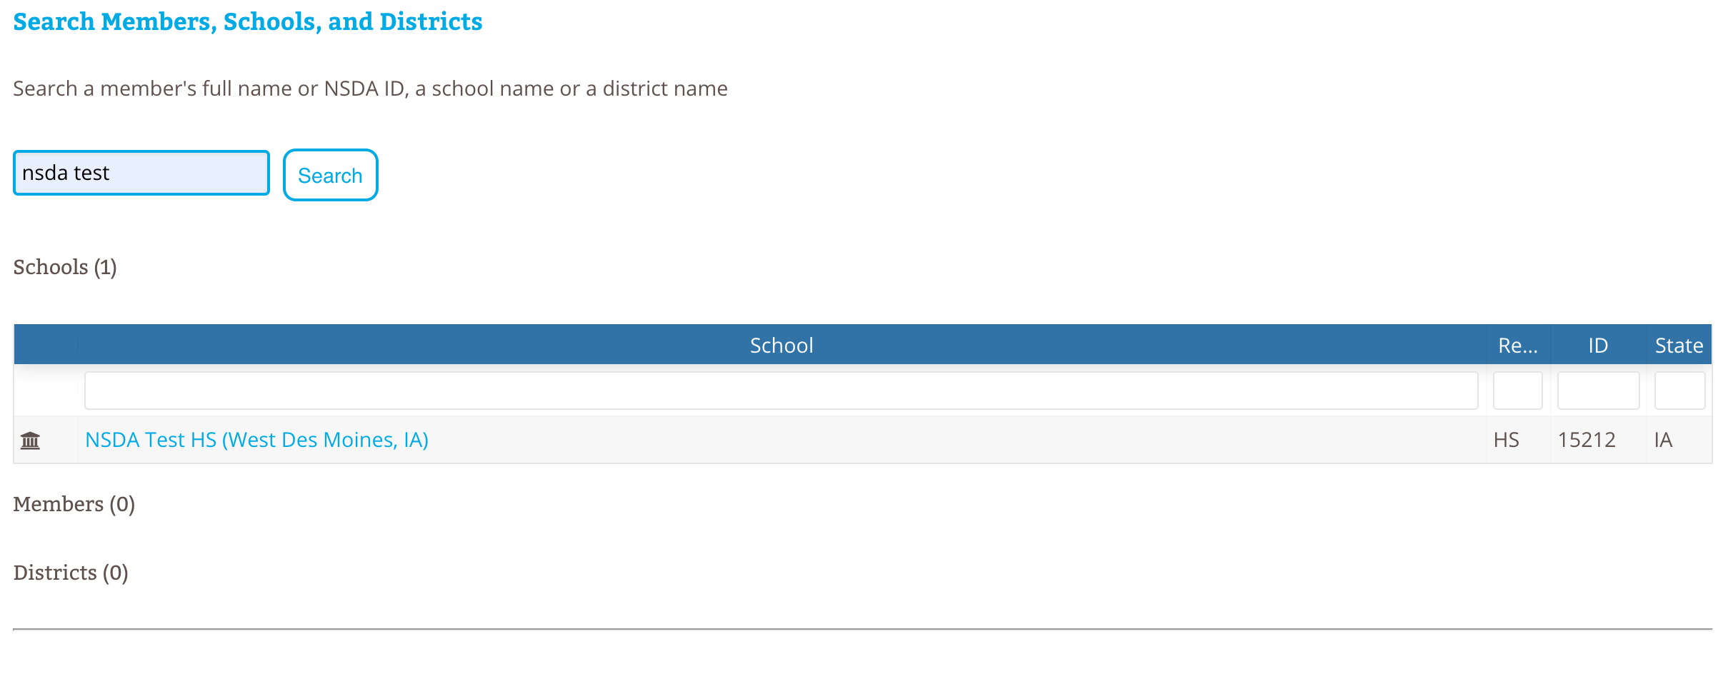
Identifying Potential Members
WE ARE SPEECH & DEBATE
Notes:
Language from Pam and Joe
Why slide – overall goal

Slide 5
Connecting with a Decision Maker
Identify key contacts at the school, likely the principal, and reach out
Use our email template and sample administrator letters to pitch your idea and secure a meeting.
Cover:
Who you are and why you’re passionate about starting a program
A sample performance so they can frame the conversation, if desired
What’s in it for them, i.e. school impact
Request to meet and intent to follow up
WE ARE SPEECH & DEBATE
Notes:
Language from Pam and Joe
Why slide – overall goal

Slide 6
Prepare for Your Meeting
Review helpful materials at www.speechanddebate.org/advocacy and www.speechanddebate.org/administrators.
Request a recruitment packet from the NSDA by emailing annie.reisener@speechanddebate.org.
Review our talking points for administrators.
WE ARE SPEECH & DEBATE
Notes:
Language from Pam and Joe
Why slide – overall goal

Slide 7
Talking Points
Speech and debate prepares students for college, career, and the future.
Literacy and communication skills
Social-emotional skills
Career and college readiness
WE ARE SPEECH & DEBATE
Notes:
Language from Pam and Joe
Why slide – overall goal

Slide 8
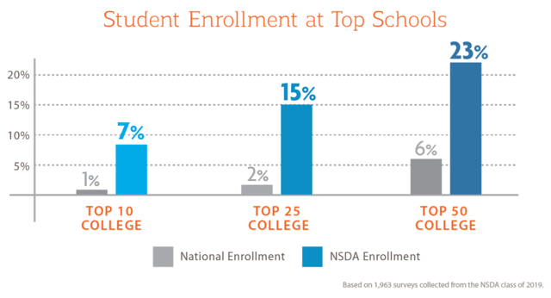
Talking Points
Speech and debate prepares students for college, career, and the future.
WE ARE SPEECH & DEBATE
Notes:
Language from Pam and Joe
Why slide – overall goal

Slide 9
Talking Points
Speech and debate prepares students for college, career, and the future.
A LinkedIn survey of more than 660+ million professionals revealed the most in demand soft skills in 2020 are creativity, persuasion, collaboration, adaptability, and emotional intelligence.
Speech and debate helps students master the soft skills employers value most.
WE ARE SPEECH & DEBATE
Notes:
Language from Pam and Joe
Why slide – overall goal

Slide 10
Talking Points
Speech and debate prepares students for college, career, and the future.
WE ARE SPEECH & DEBATE
Notes:
Language from Pam and Joe
Why slide – overall goal

Slide 11
Talking Points
There is existing local and national infrastructure of support
By joining the NSDA, you have access to educational resources, competitive opportunities, and support from experts.
High school: A local team of elected district leaders oversees competition, mentors new coaches, and facilitates learning and connection.
Help finding a coach via free job postings.
Reference local community infrastructure, if you’re familiar, or offer to serve as a resource.
WE ARE SPEECH & DEBATE
Notes:
Language from Pam and Joe
Why slide – overall goal

Slide 12
Talking Points
Speech and debate improves school environments
Administrators report the following impacts from NSDA membership:
Improved classroom performance
Higher student confidence and self esteem
Increased attendance rates
Decreased negative student behavior
Increased school pride
Increased engagement in the classroom
Higher test scores
New recognition opportunities
WE ARE SPEECH & DEBATE
Notes:
Language from Pam and Joe
Why slide – overall goal

Slide 13
Sample Explanation of Membership Impact to Administrators
Your Students
Develop the communication skills employers value
Be eligible to earn a portion of the $150K in college scholarships we give annually
Learn to analyze problems, discuss and debate them civilly, and work together to create solutions
Earn local, state, and national recognition for achievement
Build their skills with access to helpful training tools
Compete to attend the National Tournament, the Olympics of speech and debate, where 54 national champions are crowned.
Your School
Administrators report the following benefits from NSDA membership:
Improved classroom performance
Higher student confidence and self esteem
Increased attendance rates
Decreased negative student behavior
Increased school pride
Increased engagement in the classroom
Higher test scores
New recognition opportunities
WE ARE SPEECH & DEBATE
Notes:
Language from Pam and Joe
Why slide – overall goal

Slide 14
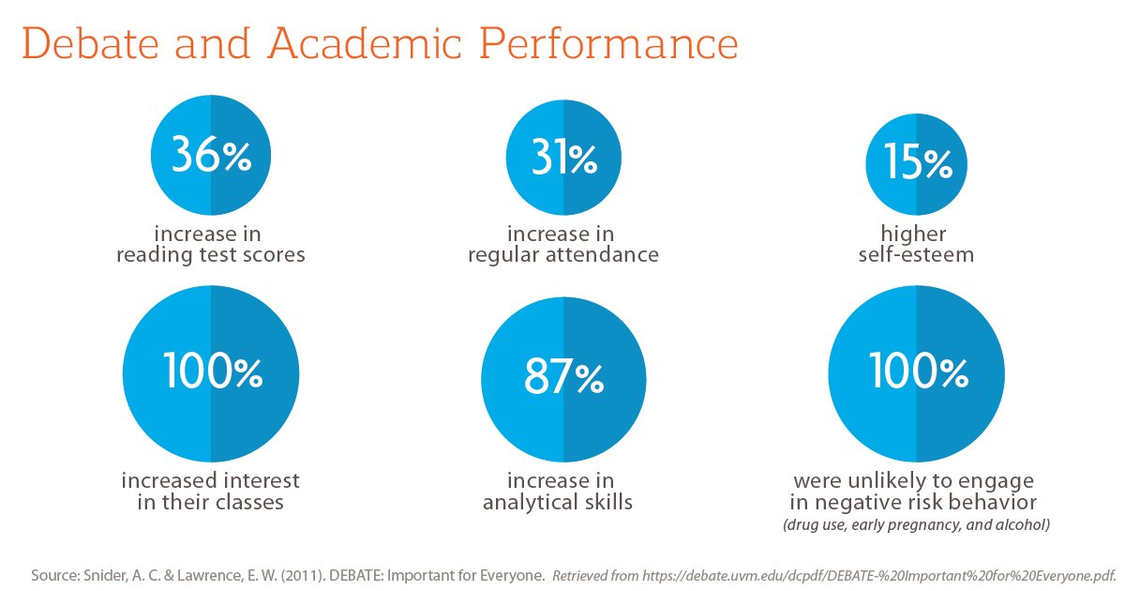
Talking Points
WE ARE SPEECH & DEBATE
Notes:
Language from Pam and Joe
Why slide – overall goal

Slide 15
Talking Points
Speech and debate improves school environments
Hear from a peer
“As a result of the “speech and debate attitude,” earned dual credits increased 800%, ACT scores increased an average of three points, and scholarship dollars offered doubled in three years.” - Douglas Wine, Principal, Holy Ghost Catholic School, NM
“Speech and debate participants do better academically across the board. They become engaged, active participants in their education and in their community. Our school has seen great improvements in student culture and spirit since we started our program.” - Errol A. Evans, Principal, Attucks Middle School, FL
WE ARE SPEECH & DEBATE
Notes:
Language from Pam and Joe
Why slide – overall goal

Slide 16
Meeting Follow Up
Send a thank you note or email to the decision maker you met with thanking them for their time and promising to follow up.
Depending on your level of engagement with the process, you may want to work through these questions in the following weeks:
How will the team travel to tournaments? What is the policy for field trips?
How will the team receive the necessary funds to compete? If financial support through the school is limited, think about alternative funding sources promoted or provided by the NSDA.
WE ARE SPEECH & DEBATE
Notes:
Language from Pam and Joe
Why slide – overall goal

Slide 17
Incentives for New Programs
We offer special grants to eligible new programs. Encourage new programs to apply!
Learn more at www.speechanddebate.org/program-grants.
WE ARE SPEECH & DEBATE
Notes:
Language from Pam and Joe
Why slide – overall goal

Slide 18
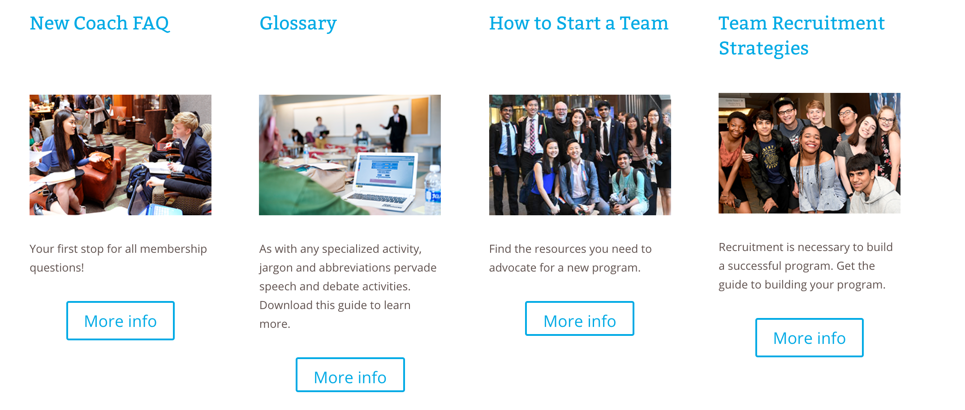
Ready, Set, Join!
New programs can sign up at www.speechanddebate.org/signup and find resources to get started coaching at www.speechanddebate.org/new-coach-quick-start-guide.
WE ARE SPEECH & DEBATE
Notes:
Language from Pam and Joe
Why slide – overall goal

Slide 19
Reminder: Where to Find Info
Advocacy resources: www.speechanddebate.org/advocacy
Admin landing page: www.speechanddebate.org/administrators
WE ARE SPEECH & DEBATE
Notes:
Language from Pam and Joe
Why slide – overall goal

Slide 20
Questions?
Advice?
Additional resources you’d like us to create?
Need help advocating for an existing program in jeopardy? We’re in your corner! Email annie.reisener@speechanddebate.org for support.
WE ARE SPEECH & DEBATE
Notes:
Language from Pam and Joe
Why slide – overall goal

Slide 21
WE ARE SPEECH & DEBATE
Notes:
Pam have other suggestions for this?

