Slide 1
Delivery in Debate
Notes:
Pam have other suggestions for this?

Slide 2
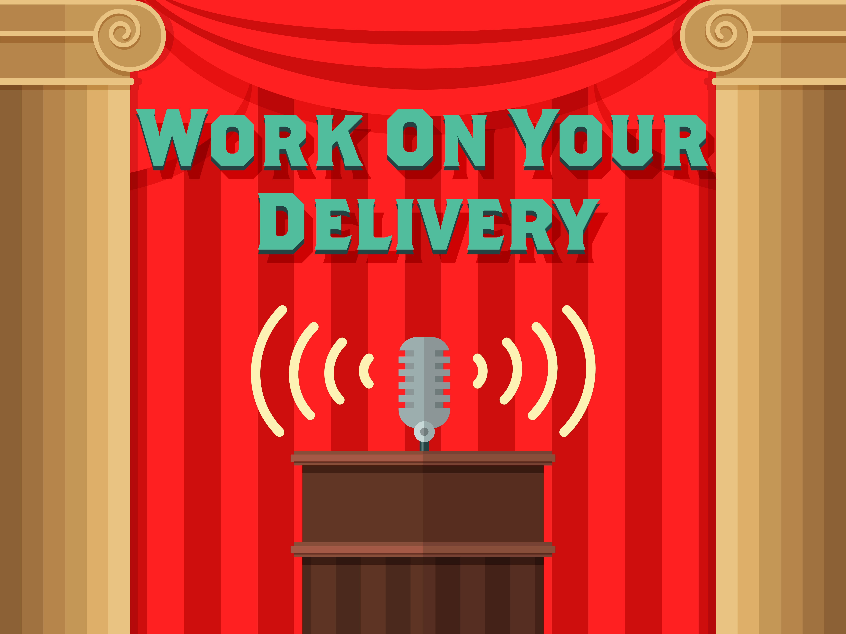
Rate of Delivery
Filler words or word crutches
Judge Paradigm
Notes:
Language from Pam and Joe
Why slide – overall goal
A delivery that is too fast can intimidate, anger, or otherwise isolate the judge, and it won’t persuade the judge. If you speeches are interrupted by many “uhs,” “ums,” and “ands,” you are probably speaking too fast.
Watch the judge’s reactions. If you are receiving signals that the judge is lost, you should slow the pace down. Monitor the judge’s reactions and adapt accordingly. Be sure to listen to the judge’s paradigm if offered at the beginning of round.

Slide 3
Rate of Delivery Activities
Videotape a practice session to get a better sense of your rate.
Make an audio recording as you read your speech and then listen to it. Listening to only the audio will allow you to focus on rate of delivery.
Notes:
Language from Pam and Joe
Why slide – overall goal
Have students complete at least one of these activities.

Slide 4
Fluency and Thought Progression
“Glue” of delivery
Transitions
SELF CONFIDENCE
Notes:
Language from Pam and Joe
Why slide – overall goal
Develop the “glue” that holds the delivery together; the fluency of transitions. Transitions are the words, phrases, or sentences that allow you to connect one thought to another. The more the progression of one thought leads to the next, the more persuasive your presentation is.
Self-confidence arises from two sources. First, you must convince yourself that you are capable of performing the event. Second, you must build your confidence through practice rounds.

Slide 5
Fluency and Thought Progression Activities
Pair/share – Develop a list of transitions that can be used in the debate. These transitions are not that much different than you would use in an essay. Get your list started with: Furthermore, therefore, for example. . . .
Notes:
Language from Pam and Joe
Why slide – overall goal
Have students complete this activity.

Slide 6
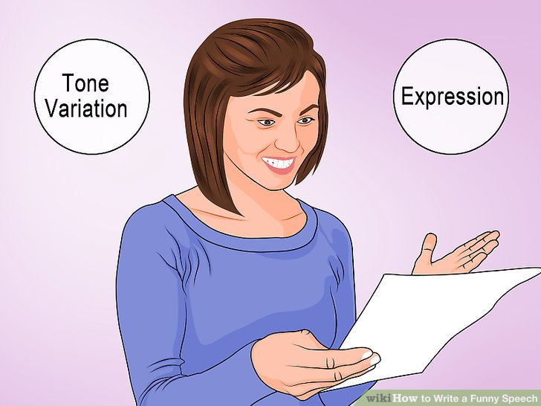
Vocal Characteristics
Vocal Variety
Pitch
Rate
Notes:
Language from Pam and Joe
Why slide – overall goal
Vocal characteristics are fundamental to many debaters; Losses can occur with an inability to “put a judge at ease.” Language choices must not be distracting; using improper grammar and/or slang terms. It is also important to vary tone to maintain the judge’s interest.
I. Vocal Variety – When we read something, especially aloud, we tend not to communicate the same way we do when we are in a conversation. Once you have finalized your debate cases, you should analyze it for vocal variety and practice it using variations in pitch, rate, and emphasis.
A. Pitch
Speakers usually tell humorous anecdotes using a higher pitch, while they present dramatic stories using a lower pitch.
If you are talking about something serious such as how civil disobedience was used to fight oppression, you are probably talking in a lower register of your voice.
Speak in your mid-range. Young women have to be very careful that their pitch does not veer too high.
B. Rate
Some debaters speak very quickly so that they can get as many arguments in a speech as possible, but in so doing they sacrifice a judge and/or an opponent’s understanding of the argument.
Speak at a conversational rate using word economy and selective material to keep you within your time constraints.
Time all material aloud. We speak more slowly than we think. Mark material that can be delayed until later speeches, especially in the negative constructive, just in case you need more time in the rebuttal portion of that speech. Trim evidence carefully and honestly and have the full source available.
Make every word count whether it is in a case or rebuttal.
Mark your case and identify which words you want said at a high pitch and which are said at a lower pitch, where you will go faster or slower, and what words or concepts you will emphasize.

Slide 7
Vocal Characteristics Activities
Pair/Share - Pick evidence at random and read orally. Have your partner critique your reading of the evidence.
Video yourself and write a critique of the performance, focusing specifically on variety, pitch, and rate.
Notes:
Language from Pam and Joe
Why slide – overall goal
Have students complete this activity.

Slide 8
Eye Contact
Deliberate
Useful
Judge Focus
Notes:
Language from Pam and Joe
Why slide – overall goal
Make it deliberate – Whether in rebuttals or during constructive speeches, whether reading or speaking extemporaneously, don’t forget to make eye contact with your judge.
Make it useful – Use eye contact to set an important point, begin and end your speeches, and to see how judges are responding to your speech.
Focus on the judge – The custom in Lincoln-Douglas is to focus on the judge, even during cross examination. The logic here is that you will never convince the opponent to suddenly change his position. But the judge is the person in the room whom you are convincing to decide that you have done the better job of debating the topic.

Slide 9
Body Language
Stance
Movement
Gestures
Facial Expression
Notes:
Language from Pam and Joe
Why slide – overall goal
Stance – Excellent posture tells your audience that you are knowledgeable, open, and engaged. Feet should be shoulder width apart and your chin parallel to the ground. Weight should be evenly balanced between your legs, hands hanging loosely at sides.
Movement – Generally speaking, because the judge should not be distracted from their flow, pacing or moving during the speeches is not customary for Lincoln-Douglas speakers. Establish an agreed upon area for cross examination and speaking. Remain on the same plane as your opponent during cross, even though you will be looking at the judge.
Gestures – Hands should never be crossed in front of the torso or clasped in the back. The “Gesture Zone” is roughly at heart level and no wider than shoulder width. Gestures are used very sparingly in debate because the judge is taking notes, but mark where you might use a few gestures to emphasize points. Don’t over practice gestures.
Facial Expression – Facial expressions are the key to showing the judge how they should feel about what you are saying. Facial expressions can be particularly important during cross-examination since they influence judges’ perceptions of both the questioner and the respondent. Generally, cross-examination is a time when judges don’t take notes and will see you side-by-side with your opponent. Be careful in responding to your opponent in a disdainful manner, making yourself look arrogant.

Slide 10
Eye Contact and Body Language Activities
Pair/Share: Help a teammate establish a proper stance and practice reading your case.
Mark where you might want to make direct eye contact or gesture during your case.
Pair/Share: See what your partner thinks about your choices for eye contact and gesture and do the same for them. Don’t forget posture!
Notes:
Language from Pam and Joe
Why slide – overall goal
Have students do at least one of these activities.

Slide 11
Special Problems of Debate Delivery
Attitude of the Speaker/s
Extempore Ideal
Memory and Use of Notes
Speed of Delivery
Reading Aloud
Notes:
Language from Pam and Joe
Why slide – overall goal
Attitude of the speakers – Show respect for opponents and for the worth of ideas. Debaters should display courtesy and fair-mindedness at all times. Arrogance is for the loser.
Extempore ideal – Know your own case so well, in outline form, that you can easily recall it as you speak and thus adapt the wording of it to the situation at hand.
Memory and use of notes – Wise use of notes can leave the speaker free to use personal phrasing for ideas, free to maintain eye contact with the audience, and free to use vocal variety of pitch, volume, and rate as appropriate. As you learn to debate you will move from small manuscripts to be read aloud to a goal of speaking from an outline extemporaneously, with items to be read aloud or referred to during the speech (evidence) at your side at the lectern.
Speed of delivery – A hurried delivery is often a sign of poor case analysis. The rapid delivery shows an uncertain approach where the speaker tries to throw in every conceivable idea and fact in hopes that one of them will work. The intelligent debater selects only the best ideas and arguments before rising to speak and does not try to deluge the audience with a flood of words.
Reading aloud – Mark your text so that you do three things: stress key words, keep eye contact with the judge, and vary the rate and the length of pauses to avoid speeding up while reading.

Slide 12
Special Problems of Debate Delivery Activities
Take an old flowsheet and deliver a first negative constructive without using evidence.
Video tape your next practice round and write a critique of your performance. (You will always be your worst critic.)
Notes:
Language from Pam and Joe
Why slide – overall goal
Have students do these activities.

Slide 13
Cross Examination (Questioning) Delivery
Confidence
Control
Tone
Questions
Regaining Control
Notes:
Language from Pam and Joe
Why slide – overall goal
Cross-examination (CX) is one of the best times that you have as a debater to truly impress the judge. Since it’s one of the first times that you get to stand in front of the judge and look him or her in the eye while your opponent also speaks, it is critical that you appear confident.
When you are asking questions, you want to remain in control of the CX; this is your time to ask questions, not your opponent’s. When trying to maintain control, you should NEVER be rude or off-putting. CX is not the place to make or engage in arguments; it is the time to set up the arguments that you will then make in your speech. Never say (with attitude), “This is my cross examination and I get to ask the questions.”
There are two kinds of questions that you can ask, open- or close-ended questions. Open-ended questions require more than a “yes” or “no”. Close-ended questions typically only necessitate a “yes” or “no”. If you are trying to pin your opponent down on a certain argument, do not ask open-ended questions because this gives them the opportunity to try to weasel their way out of your question and interfere with your argument.
If you need to regain control, try verbal cues such as, “I understand, but let me ask you this” or “Thank you. Let me ask you this question.”
Listen! It doesn’t matter if you ask the best question that you could have, if you do not listen to what your opponent has to say.

Slide 14
Cross Examination (Questioning) Delivery Activities
Watch video of recorded rounds at www.speechanddebate.org to observe how cross examination is done.
Pair/Share to brainstorm some small phrases that you can use to redirect the CX and practice them to appear confident and in control.
Pair/Share: Have your partner present their AC. Increase the cross examination to five minutes, or beyond. See how they do. Did you run out of questions? Can you think of some pre-written questions that you can prepare?
Notes:
Language from Pam and Joe
Why slide – overall goal
Have students do one or more of these activities

Slide 15
Questions?

Slide 16
Notes:
Pam have other suggestions for this?

