Slide 1

The Classy and the Dapper:
Congressional Debate
Moving from “Point A” to “Infinity and Beyond”
Notes:
Pam have other suggestions for this?

Slide 2
Agenda
What’s going on [at least for the next 40 minutes]:
Recap Event and Structure
Review Terms
Analyze Legislation
Prepare Speeches
  Refutation
Refocus Presentation [in speeches]
Strategy
Notes:
Language from Pam and Joe
Why slide – overall goal

Slide 3
Objectives
By the end of this ‘webinar’, I will be able to:
Recall common terms used in Congress
Outline the structure of a session
Delineate arguments from legislation
Draft a speech [outline]
Deliver a speech
Notes:
Language from Pam and Joe
Why slide – overall goal

Slide 4
Overview: Event Structure
What is it?
  Simulation of the United States Congress (both chambers)
What happens?
  Discuss/Debate “Legislation”
  Affirmative/Negative- questions
For how long?
  2-3 hours
Notes:
Language from Pam and Joe
Why slide – overall goal
-15-25 people
-Legislation: Policies (Topic)- Foreign and Domestic. These do change each tournament!! But don’t be surprised if you see repetitive topics.
-Break session based on time

Slide 5
Review:Terms
Terms that will be referenced throughout:
Docket: Packet full of legislation (bills and resolutions)
Authorship: First speech given on a bill/res.
Presiding Officer: Student elect individual who runs the session
Caucus: Formal/ informal discussion with competitors about how to order the agenda [docket]
Motions: Actions in the chamber (how to do things)
Notes:
Language from Pam and Joe
Why slide – overall goal
SEGUE: Before you compete, you receive the docket (topics). You prepare by researching! But first you must examine the topics...

Slide 6
Delineate Arguments
From Legislation Text
Notes:
Language from Pam and Joe
Why slide – overall goal
But first...what do these things look like?

Slide 7
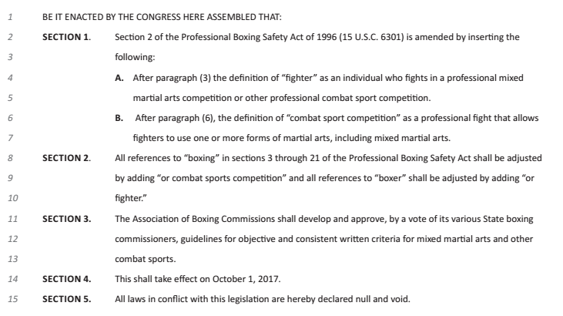
Legislation: Bills
The Muhammad Ali Expansion Act
When passed, are implemented into law.
Have 5 sections- each serves a different purpose- and all are up for debate.
Notes:
Language from Pam and Joe
Why slide – overall goal
-That’s why bills are preferable since there is technically more ground to debate.

Slide 8
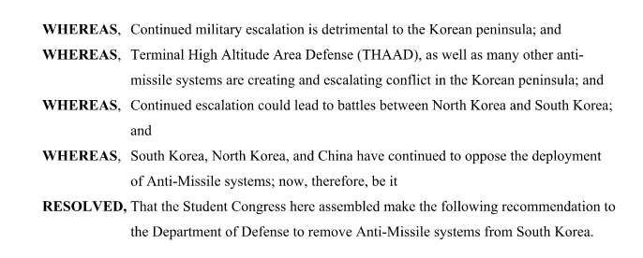
Legislation: Resolution
A Resolution to Remove Anti-Missile Systems from South Korea
When passed, simply become an outline for a bill.
Shorter- debate is focused on the “resolved” clause(s)
Constitutional Amendments follow this outline
Notes:
Language from Pam and Joe
Why slide – overall goal

Slide 9
Where do I start?
The Muhammad Ali Expansion Act
Read the bill text
Read background information (if necessary)
Create advocacy based on section 1
  Shift that based on the preceding sections
*Keep the text in mind when you prep.
Notes:
Language from Pam and Joe
Why slide – overall goal
-How to research is in a document attached- how to avoid arguments being stolen/ how to shape your argument to avoid repetition.

Slide 10
Where do I start?
A Resolution to Remove Anti-Missile Systems from South Korea
Read the resolved clause
Read background information
Create advocacy based on resolved clause
Notes:
Language from Pam and Joe
Why slide – overall goal

Slide 11
Common Questions/Concerns
How do I research?
  In a document attached (based on your skill level).
Where do I keep my research?
  Wherever you’re comfortable- Dropbox, Google Docs., Evernote, etc.
What if my arguments are stolen?
  Depending on how you’re prepping this can be avoided....read more in the research document attached!
Notes:
Language from Pam and Joe
Why slide – overall goal
-Depends on the size of the squad.
-Make sure you download/ have your evidence when you’re ready

Slide 12
Speech Structure
Reminder: Speeches are 3 minutes
Notes:
Language from Pam and Joe
Why slide – overall goal

Slide 13
Speech Structure: General Overview
Intro
Point 1
  Refutation
Point 2
  Refutation
Conclusion
Notes:
Language from Pam and Joe
Why slide – overall goal

Slide 14
Intro Conclusion
3 Parts
-Attention Getting Device (AGD)
-'Introduces' your speech; gain attention; nothing crazy
- Link:
-Narrows down your attention
getter to the justification
-Justification:
-Explains why I'm listening to your
speech.
-Equivalent to a thesis: One statement to describe your advocacy
-Ideally, you want to follow the inverse of the intro...but time doesn’t always allow for that
-Structure goal: Link to advocacy
-Strategic goal: Leave a lasting thought
Notes:
Language from Pam and Joe
Why slide – overall goal
Purpose of an intro: Introduce your advocacy; yes should be attention grabbing but if it doesn’t follow a structure to segue into your speech it doesn’t serve a purpose

Slide 15
Point Construction
4 Parts:
Claim:The general argument that you're making
Warrant: The reason why your claim is true
Evidence: The “how” or “why” connection between the claim and warrant (data, literature)
Impact: Explains what your argument means/ who it affects
Example
“Military aid is a prerequisite to effective development in the Sahel Region”
“That’s because if the Sahel Region is not stable, developmental projects cannot be carried out”
Dak Prescott for the Belfer Center at Harvard University [May 2017]:“Insurgencies can use violent attacks to purposefully disrupt the project and threaten the security of the project staff, leading the implementing agency to withdraw. Even if it continues, insurgents can hinder its successful implementation by attacking project staff and destroying project infrastructure.”
Obvious impact: Protect innocent lives Deeper impact: More stable, more investment
Notes:
Language from Pam and Joe
Why slide – overall goal
Flow/ lay judge friendly
Set up to allow room for refutation/analysis
Easy to adapt to unique structure
Fit in to stand out

Slide 16
Point Construction
“Construction” is extremely diverse
More structures are moving away from the traditional format. That means:
  More general explanation of argument instead of strict structure
  Reference of cites rather than analysis
  Less focus on impact analysis
Notes:
Language from Pam and Joe
Why slide – overall goal

Slide 17
Refutation
Critical to moving debate forward (tearing down arguments, creating new ground, etc.)
  Flowing the session helps!!
How (most basic form):
  Falsify (prove not true)
  “Even if” (true...but not unique because...)
  Minimize (true...but only kind of)
  Outweigh (aff. arg/ neg. arg are more important)
Presentation:
  Name, recap, response+ reasoning
  Ex: “Ms. Lane argued X, that's false because...”
Notes:
Language from Pam and Joe
Why slide – overall goal
-Flowing attached in a different document.

Slide 18
Common Questions/Concerns
Do I have to adhere to this exact structure?
  No! This is just an argument structure that’s rather effective. Do what you’re comfortable with.
Where do I put refutation in my speeches?
  Doesn’t matter as long as it’s there. There are strategic places to put your refutation (direct clash for example), but as long as your segues are clear the place isn’t critical.
Are there refutation speeches?
  Yes. Congress, like the other debate events, has a structure of flow:
    Constructive, Refutation, Crystallization
Notes:
Language from Pam and Joe
Why slide – overall goal

Slide 19
Presentation
The Big 3: Volume, Clarity, Eye Contact
Notes:
Language from Pam and Joe
Why slide – overall goal
But first...what do these things look like?

Slide 20
Presentation: Volume
Project- Speak from diaphragm
Big Room Performances
Notes:
Language from Pam and Joe
Why slide – overall goal

Slide 21
Presentation: Clarity
Speed
  Speak slower than you may feel comfortable - it will also improve fluency
  However, make sure you can still fit within allotted time
Fluency
  Avoid using filler words (um, uh, like, etc.)
  Use strategic pausing to organize thoughts
Emphasis
  When?
    Important numbers/statistics
    Important words/phrases
  How?
    Stress important words
    End up/down
    Pause after important words or phrases
Notes:
Language from Pam and Joe
Why slide – overall goal

Slide 22
Presentation: Eye Contact
Look up when possible
  Less important than others - in this competition don’t sacrifice fluency, etc. for eye contact
Makes it seem like you know what you are talking about
Don’t type out or write out your whole speech
Notes:
Language from Pam and Joe
Why slide – overall goal

Slide 23
Common Questions/Concerns
Is presentation more important than argumentation/ refutation?
  No. It can help you but overall there should be a [somewhat] equal balance between argumentation, refutation, and presentation.
Should I change anything about my presentation depending on my judging panel?
  No. You should be well rounded enough in various sectors that it’s appealing all around.
Notes:
Language from Pam and Joe
Why slide – overall goal
-As long as you follow the general standards of a clean speaker you won’t have any issues with #2.

Slide 24
Strategy
Notes:
Language from Pam and Joe
Why slide – overall goal
-Most unique aspect of Congress: Strategy won’t make or break you but it can set you up for a better round.

Slide 25
Strategy: Speaking Early
If you’re limited in research/evidence to refute other speakers:
  Give the constructive points that are pre-prepared
If you want to establish precedence and give yourself better recency/flexibility to speak whenever you want for the following bill
Notes:
Language from Pam and Joe
Why slide – overall goal

Slide 26
Strategy: Speaking Middle/Late
Build: You should also advance and bolster your own side
  Don’t rehash- explain how what you’re adding to the debate changes it
Refute: Follow the burden of refutation as the debate moves forward
Crystallize: Explain what’s happened in the debate and why it matters
Notes:
Language from Pam and Joe
Why slide – overall goal

Slide 27
Strategy: Presiding
Strategic relief!
  Lighten your speaking load
Accolades and Respect
  Show your peers and judges you are versatile and worthy of acclaim.
Political Capital
  Run the chamber in exchange for clout (ethically)
POing outrounds is risky, POing finals is a #statement
Notes:
Language from Pam and Joe
Why slide – overall goal

Slide 28
Strategy: Leadership
Don’t.Be.Rude.
  Don’t call previous question with the intention of cheating people out of speeches
No one gets extra points for being the first to nominate a docket, call the previous question or go to recess… do not jump up!
If no one really knows what’s going on before the round begins, take a leadership role!! (Grab that marker and start asking for others opinions)
  Start talking with the chamber and take a lead in preparing the docket so it doesn’t take 56 hours out of speaking time when the round starts.
  Include that new kid or the quiet group… they are just nervous like all of us were at one point
Notes:
Language from Pam and Joe
Why slide – overall goal

Slide 29
Strategy: Ethics
Be friendly!!! Talk about life outside of debate (because that exists) and make friends!!!
Save your evidence as pdf files on your computer. Need full text.
Follow the rules- don’t find a way around
Cheaters never win. The Patriots did. That’s why we don’t like them.
Notes:
Language from Pam and Joe
Why slide – overall goal

Slide 30

“Some of the great leaders in history were not adored, but respected. My advice to leaders- stop trying to please everyone and do what you believe is best”
— Nick Saban, University of Alabama (Head Football Coach)
Notes:
Language from Pam and Joe
Why slide – overall goal
-Congressional debate is known for leadership- win it on authenticity, not the performance you put on.

Slide 31
Notes:
Pam have other suggestions for this?

