Slide 1
Presentation Title
Goes Here
Presenters Names Here
WE ARE SPEECH & DEBATE
Notes:
Pam have other suggestions for this?

Slide 2
Best Practices for Accessibility
Accessibility Guidelines for PowerPoint:
Use a sans serif font (e.g., Calibri, Arial, Verdana, etc.).
Use a large font size—at least 22 point.
Use a dark text font and a light-colored background.
Text on a slide should have nothing behind it (don’t place text over watermarks or images).
Provide “alternative text” descriptions for all photographs, images, clip art, graphics, maps, and charts. These items cannot be read by screen readers. To embed "Alt Text" descriptions right-click the graphic and select “Edit Alt Text…” from the dropdown menu.
WE ARE SPEECH & DEBATE
Notes:
Language from Pam and Joe
Why slide – overall goal

Slide 3
Enter Title Here
Title Here
Point 1
Point 2
Point 3
WE ARE SPEECH & DEBATE
Notes:
Language from Pam and Joe
Why slide – overall goal

Slide 4
Title Goes Here
Title
Number 1
Number 2
Title
Number 1
Number 2
WE ARE SPEECH & DEBATE
Notes:
Language from Pam and Joe
Why slide – overall goal

Slide 5
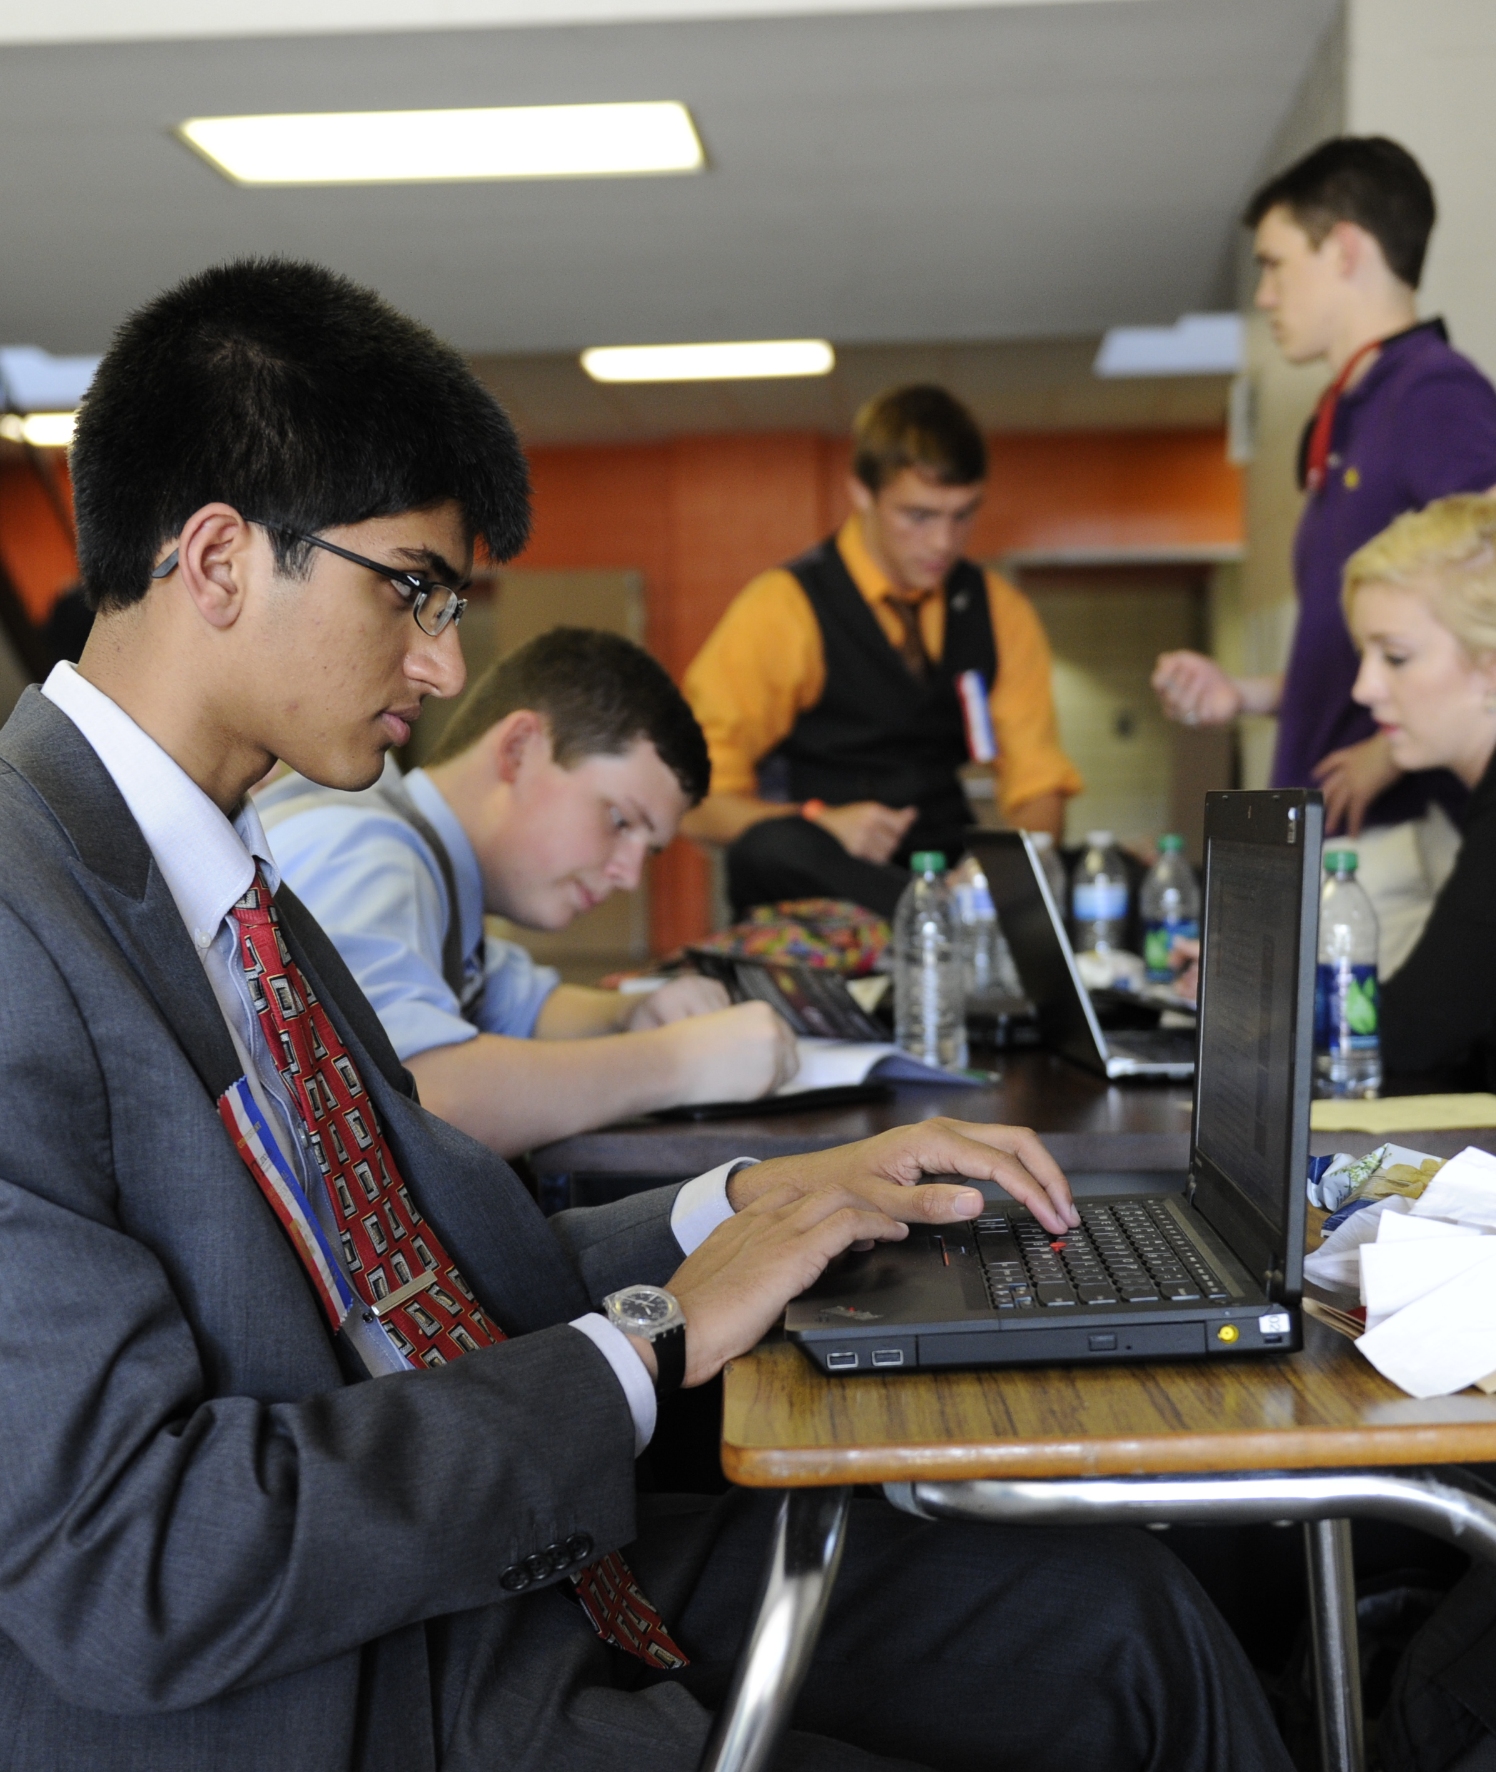
“
Quote text quote text quote text quote text quote text quote text quote text quote text quote text quote text quote text quote text quote text quote text quote text quote text quote text quote text quote text quote text quote text quote text quote text quote text quote text quote text quote text quote text quote text.”
—Name, Last Name, role
WE ARE SPEECH & DEBATE
Notes:
Language from Pam and Joe
Why slide – overall goal

Slide 6
Title
Enter Title Here
Text block
List:
One
Two
Three
WE ARE SPEECH & DEBATE
Notes:
Language from Pam and Joe
Why slide – overall goal

Slide 7
WE ARE SPEECH & DEBATE
Notes:
Pam have other suggestions for this?

