Slide 1
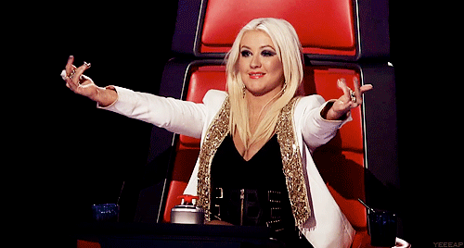
Round Overview 2.0

Slide 2
Let’s Walk Through It
1AC - Read the case. (EASY)
1NC - Attack! Read T, DA, CP, Ks, Advantage Attacks, Solvency Attacks
Put the puzzle together.
2AC - Respond to EVERY part of the 1NC.
Notes:
As an overview of getting to the rebuttal speeches, let’s take a few minutes to recap what should be in the constructive speeches. The 1AC will present a problem, a cause, and a solution to give justification “at first glance or on face (Prima Facie) a case to adopt the resolution. The 1st Neg will have worked out a strategy with the 2nd neg of how to attack the affirmative. So, the 1NC could have the following “off-case” arguments—Topicality, disadvantages, counter-plan, kritiks, advantages or net benefits attacks, and/or solvency attacks.
The 2nd aff. must counter all 1NC arguments, and extend the aff reasons for change and provide impact to their arguments.

Slide 3
Let’s Walk Through It
2NC - Take a few (2-3) arguments from 1NC and EXPLODE and/or present new arguments!
1NR - Take the rest* of the arguments from the 1NC and EXPLODE!
1AR - Respond to EVERY part of the Negative Block! (HARD)
Notes:
The 2NC has several options: 1. The 1NC CAN put out all of the o

Slide 4
Let’s Walk Through It
2NR - BIGGEST STRATEGY DECISION COMES HERE:
What are you ABSOLUTELY winning?
Don’t go for EVERYTHING!
Make smart decisions.
2AR - Respond to 2NR; Strategy time!

Slide 5
“STRATEGERY”
Strategy == FUN!
Positive (not negative) time trade-offs.
Notes:
We are looking for positive time trade-offs. (If it takes you 2 minutes to argue something but I can answer it in 1 minute, that’s a positive time trade-off.) We definitely don’t want negative tradeoffs.

